Slide 1




The Basic Clinical Exam:
Key to Early Identification of Sick Animals
Ralph Bruno, DVM, MS; Ellen Jordan, PhD; Juan Hernandez-Rivera, PhD; and Kevin Lager, MS -
Texas AgriLife Extension Service
Mireille Chahine, PhD – University of Idaho
Robert Hagevoort, PhD – New Mexico State University
The entities involved in the development of this material do not support one product over another and any mention herein is meant as an example, not an endorsement.
Notes:
Finding and treating sick animals early is the key to maintaining a safe, nutritious food supply. On dairies, this begins with a basic physical exam of the cow.

Slide 2
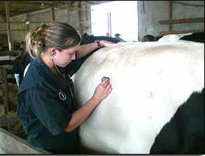
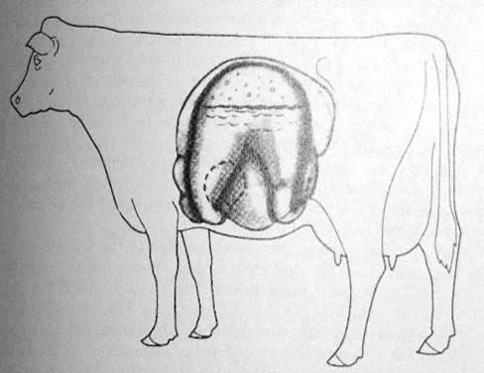
Physical Exam of the Dairy Cow
Notes:
Frequently a staff member, trained by the herd veterinarian, identifies cows that appear abnormal and conducts a basic exam.

Slide 3
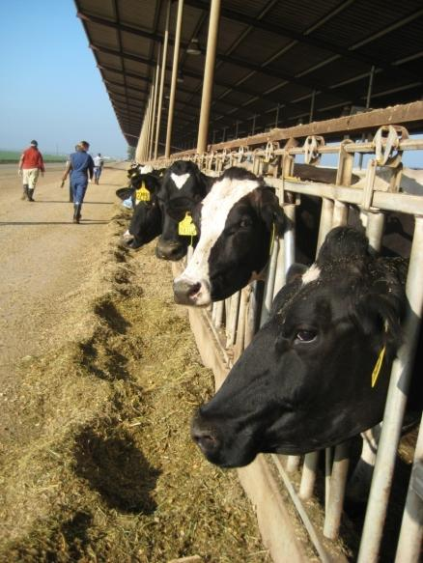
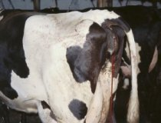
Goals of a Physical Exam Program
Identify sick cows early
Treat sick cows early
Prevent spread of diseases
Protect the food supply
Improve animal welfare
Notes:
The goals of a Physical Exam Program include:
Identify sick cows early,
Treat sick cows early,
Prevent spread of diseases,
Protect the food supply, and
Improve animal welfare.
Besides these common goals, dairy employees may be the first to see abnormal symptoms that may indicate a foreign or emerging disease. Anytime unfamiliar symptoms are seen, the herd owner, veterinarian or manager should be notified.

Slide 4
The Normal Cow Parameters
Parameter | Normal Value
Heart rate | 60-70/minute
Respiration rate | 30/minute
Temperature | 101.5 - 102 °F
Rumen contractions | 1-2/minute
Notes:
To conduct a basic physical exam, learn the normal characteristics of a cow. For example, the cow’s normal heart rate is 60-70 beats per minute; respiration rate is 30 breaths per minute; temperature is 101.5 to 102 °F; and rumen contractions occur once or twice per minute.

Slide 5
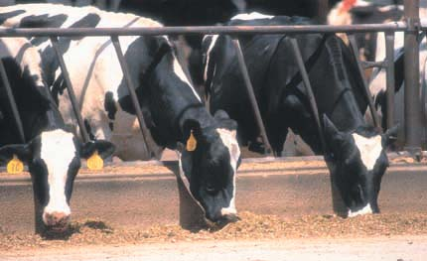
Potential Disorders
Ketosis (urine or milk)
Displaced abomasum (DA)
Mastitis
Metritis and endometritis
Lymph nodes
Lameness – feet and legs
Lesions – mouth, feet, teats
Endemic diseases
Unusual symptoms that could indicate a Foreign or Emerging Disease
Notes:
Once you determine that a cow is “abnormal”, use your powers of observation to determine what the problem is. Some potential disorders include: ketosis (urine or milk analysis), displaced abomasum (DA), mastitis, metritis and endometritis, lameness (feet and legs), lesions (mouth, feet, or teats), other common diseases (IBR, BVD, leptosporosis, PI₃, etc.), and unusual symptoms that could indicate foreign or new diseases.

Slide 6
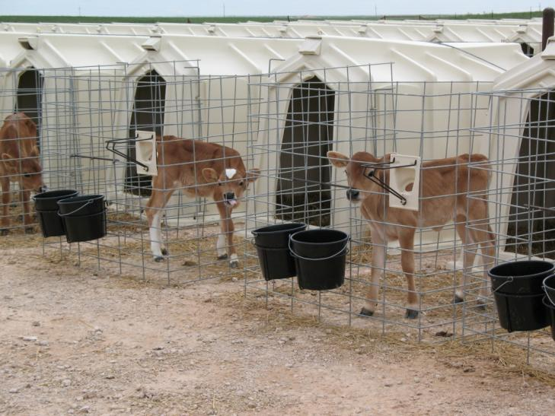
Groups of Animals
Recently calved or “fresh” cows
Non-stressed animals
Recently purchased
Stressed animals
  Weaning
  Environmental
  Management Change
  Transportation
Notes:
Depending upon the dairy there are a number of different groups of animals that require differing amounts of attention. Typically, calving and recently calved or “fresh” cows receive the most attention on dairies. Today many dairies conduct a brief physical exam on every cow for the first ten days after they calve.
After the initial intense observation, most animals enter the lactating pens, where they continue to be observed on a daily basis for abnormal behavior. If any abnormal signs are detected, these “non-stressed” animals will then be evaluated further.
Each dairy has its own guidelines for isolating and monitoring recently purchased animals as well as those that have undergone some type of stress. Increased monitoring and evaluation are indicated whenever an animal is subject to a stressor. Some common stressors include: weaning, weather changes, pen moves, and other management changes.

Slide 7
Multiple Stressors Build
Breaking point
Heat stress
Overcrowding
Grouping stress
Resources to deal with stress
Resource for production
Poor facilities
Metabolic stress
Adapted from Drackley, 2002
Notes:
Whether the stress comes from metabolic stress, grouping changes, heat stress, overcrowding or unsanitary conditions; the cow uses more and more of her resources to deal with the stress. As a result there are decreasing resources for her to use for production.

Slide 8
… until They Reach the Breaking Point for the System
Ketosis Retained Placenta Metritis
Disorders and Postpartum Diseases
Adapted from Drackley, 2002
Notes:
As these multiple stressors are stacked upon each other, the cow finally reaches a breaking point where she becomes ill.

Slide 9
Immune Suppression
During the Transition Period
130
Suppression occurs 2 weeks before and after calving
Vaccine response is compromised during the transition period
120
Antibody Production (Lab. Standards %)
110
100
90
-5
-4
-3
-2
-1
0
1
2
3
4
5
Goff (2006)
Weeks to Calving
Notes:
9
Fresh cows are even more susceptible to disease because their immune system is depressed. Immune suppression starts two weeks before and continues for two weeks after calving. This is the reason we need to take extra care in designing vaccination programs around this time. Immune compromised cows do not respond as well to vaccination.

Slide 10
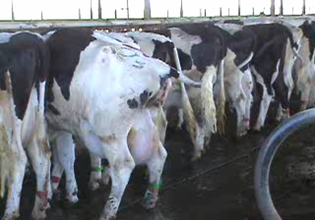
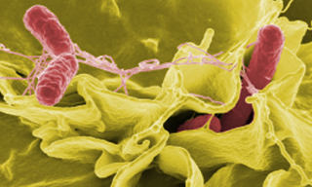
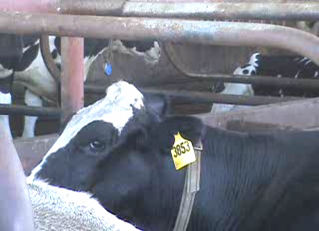
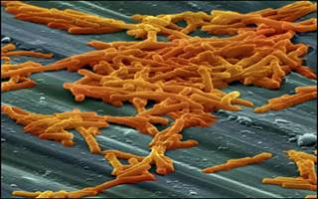
Immune Suppression in Fresh Cows Makes Them Susceptible
Salmonella
Clostridium
Pneumonia
Notes:
Immune suppression around calving makes these cows more likely to be infected by disease causing organisms such as salmonella, clostridium, and pneumonia.

Slide 11
How to Identify Disease in Fresh Cows: Four Areas of Focus
Temperature
Appetite
Uterine Discharge
Hydration Status
Ideally, check each fresh cow daily during the first 10 days after calving!
*Important - this is a TWO man job: Technician at the back of the cow and a helper at the head of the cow.
Notes:
For daily monitoring, focus your attention on four main areas:
Temperature,
Appetite,
Uterine discharge (particularly fresh cows), and
Hydration status.

Slide 12
Develop a Systematic Approach
Attitude
  eyes and ears
Appetite
Hydration
Temperature
Feet and Legs
Udder
Uterus
Heart Rate
Lungs
Rumen
Manure
Notes:
Develop a systematic approach to check the cow from one end to the other. Develop your own routine. Observe attitude, appetite, hydration, and temperature. Systematically check eyes and ears, feet and legs, udder, uterus, heart rate, lungs, rumen and manure. By using one order consistently you will be less likely to miss something.

Slide 13
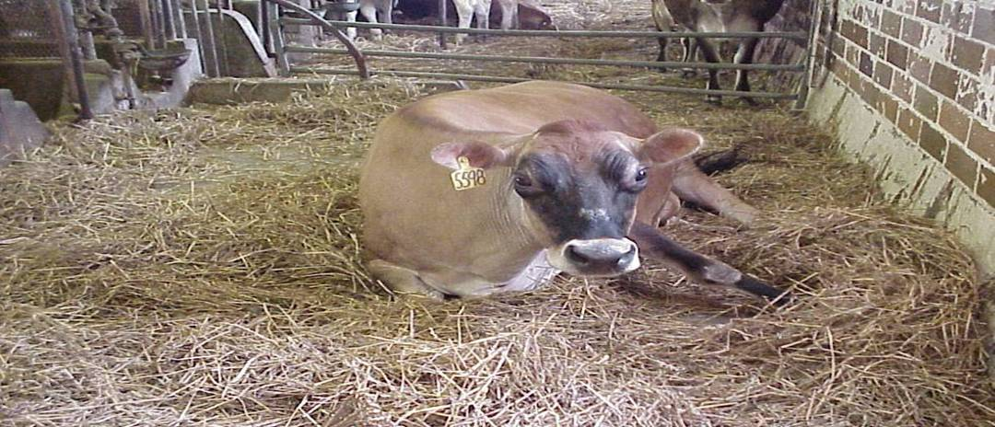
Start with Attitude
1 – Alert 2 – Mildly Depressed 3 – Depressed
Notes:
Start with the cow’s attitude - Look at her eyes and ears. Sunken eyes and droopy ears indicate a sign of something wrong. Sick cows typically seek solitude, lie down in corners of the corral and move slower with less energy than healthy cows. Grade her as alert, mildly depressed, or depressed. For those cows that are mildly depressed or depressed, start looking for other symptoms to figure out why.

Slide 14
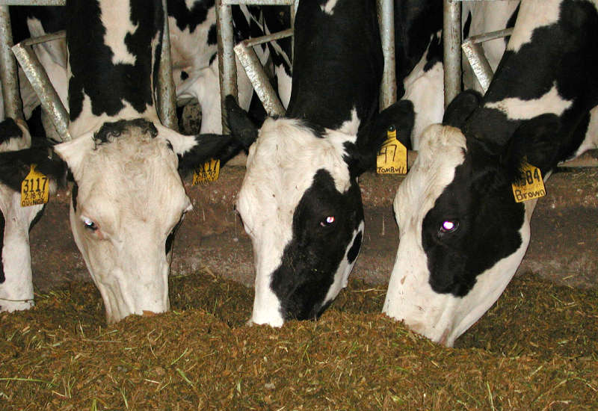
Monitor - Appetite
1- Aggressive | 2 - Normal | 3 – Not eating
Compare with other cows around her in the same pen
Notes:
Watch for cows that don’t come up to the feed bunk to eat. Look at how much of the feed in front of a cow was eaten. Compare her with other cows around her in the same pen. - Grade her appetite as aggressive, normal or not eating. If she is not eating that means you need to find out why.
Panting and excessive salivation can be signs the animal isn’t feeling well. Again compare her behavior to other animals in the same pen.

Slide 15
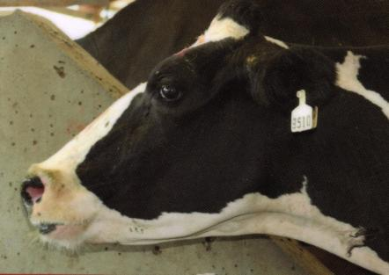
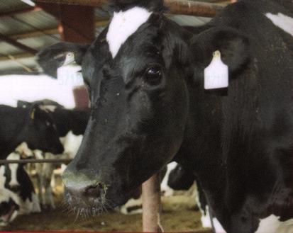
Hydration Status
Different levels of dehydration
Skin test (skin elasticity)
Eyes
sunken eyes = severe dehydration
Fluid therapy is important in severe dehydration
Notes:
Use a skin test to check for hydration. Normally when you pinch a fold of skin in a cow’s neck between your fingers it flattens out immediately upon release. In a cow that is dehydrated, it will stay “tented” or raised for a period of time. The longer it remains tented the more dehydrated the cow. Look at her eyes, if they are sunken she may be suffering from severe dehydration. It is very important to provide fluid therapy to cows that are in severe dehydration.

Slide 16
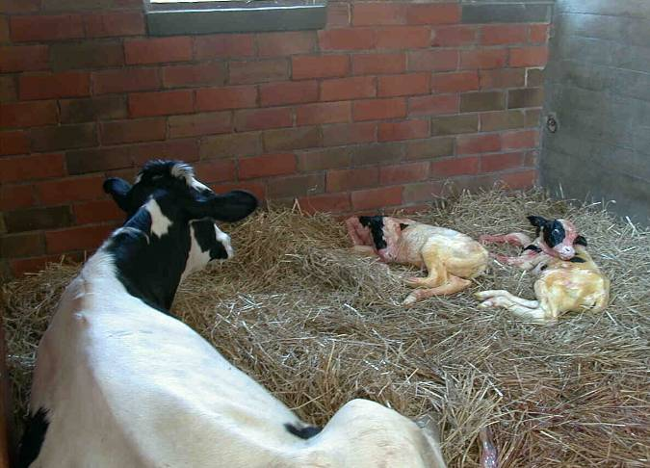
Even “Normal Looking” Cows Must Be Monitored
Retained Placenta (RP)
Abortion
Twins
Difficulty Calving (Dystocia)
Milk Fever
(Low Calcium)
Notes:
Even normal looking cows must be monitored to catch early symptoms. When cows retain their placenta or the fetal membranes, abort, twin or have difficulty calving they are more likely to have problems later. Spending a little extra time checking those cows that had problems earlier can lead to early identification of other problems. Cows with low calcium levels or milk fever may not be able to get up. These cows need extra attention as well.

Slide 17
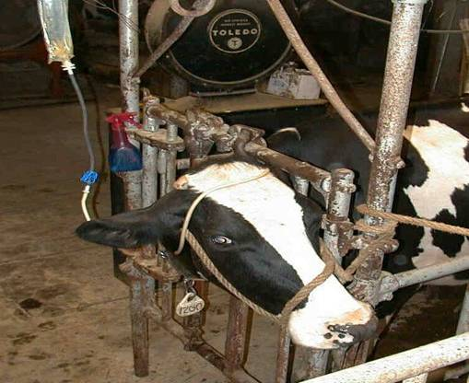
Record Diseases and Treatments for Each Cow
Dystocia or difficult calving
Milk fever or hypocalcemia
Metritis
Ketosis
Retained placenta or RP
Displaced abomasum or DA
Pneumonia
Mastitis
Lameness
Lesions
Notes:
Here is a list of some of the possible diseases you might find on a large dairy depending upon your training . Record the disease diagnosis and treatment for each cow. At a minimum these records should include the date, cow identification, symptoms, diagnosis, and treatment. Follow set protocols for treatment developed by the herd veterinarian. If antibiotics are necessary, follow withdrawal times for both milk and meat. If you are unsure about something, contact your herd owner or veterinarian to get help.

Slide 18
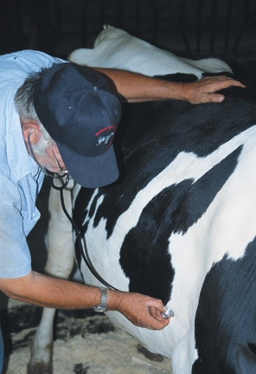

Check the Heart
Use stethoscope
(both sides)
Check for:
Heart Rate
Different Sounds
Murmurs
Observe jugular vein:
When distended it is a sign of heart problems
Notes:
Determine the heart rate by using a stethoscope. Check both sides and listen for sounds that could indicate a heart murmur.

Slide 19
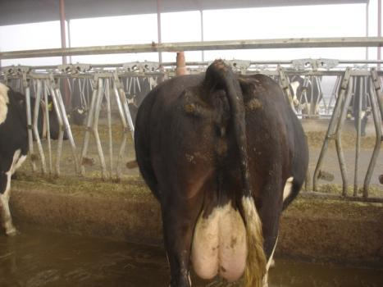
Check the Rumen
Sounds
Number of Contractions
Displacement
Rumen Distension (Bloat)
Clinical examination of the rumen includes palpation per rectum
Manure consistency, smell, color, and particle size are good tools to identify gastrointestinal disorders
Notes:
Also use your stethoscope to check the rumen. Listen to the sounds and decide if they are normal. Determine the number of contractions per minute. Check for a ping that might tell you that the cow has a displaced abomassum. Look for abdominal distension or bloating. A true clinical exam of the rumen also includes palpation through the rectum. Finally look at the manure for consistency, smell, color, and particle size. When these differ from herd mates, a gastrointestinal disorder may be the cause.

Slide 20
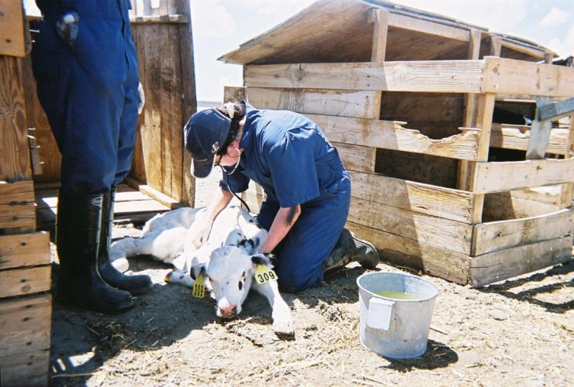
Check the Lungs
Listen to:
Lung sounds
Respiration rate
Observe for:
Nasal discharges
Congestion
Coughing
Associate findings with other clinical signs
Notes:
Check the lungs. Determine the respiration rate and listen for signs of congestion that might indicate the cow has pneumonia. Observe for nasal discharges, congestion, or coughing. Associate the finding with other clinical signs such as fever, dehydration, lack of appetite, etc. to determine if the cow has an illness or disorder.

Slide 21

Look Beyond Typical Symptoms
International travel increases the potential to bring in foreign animal diseases
  Example: Foot and Mouth Disease
Early detection of any disease can prevent its spread and minimizes the impact on the herd
Notes:
When checking a herd, you should always watch for symptoms beyond what you are used to seeing each day. Many dairy employees are immigrants and may travel out of the U.S. In addition there is more and more international travel by citizens from around the globe. This increases the potential to bring in foreign animal diseases. One example of a foreign animal disease we don’t find in the U.S. is foot and mouth disease. Early detection of any disease, including foreign animal diseases, can prevent its spread and minimizes the impact on the herd.

Slide 22
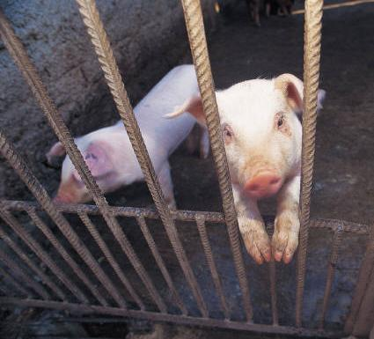
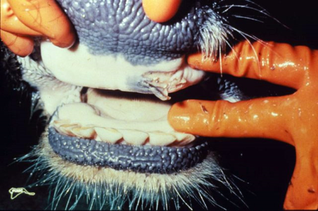
Foot and Mouth Disease (FMD)
Impacts cows, sheep, pigs, deer and other cloven footed animals
Very contagious virus
Fever and blister-like lesions on teats, tongue, lips, and between hooves
Lost milk production
ARS, 1969
USDA-APHIS, 2007
Notes:
Foot and Mouth Disease is an example of a disease we don’t usually see in the U.S. Foot and Mouth Disease is caused by a virus. It impacts cows, sheep, pigs, deer and other cloven hoofed animals. It is a very contagious virus. Animals may have a fever and blister-like lesions on teats, tongue, lips, and between hooves. Milk production decreases dramatically in dairy cows.

Slide 23
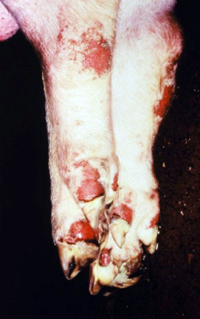
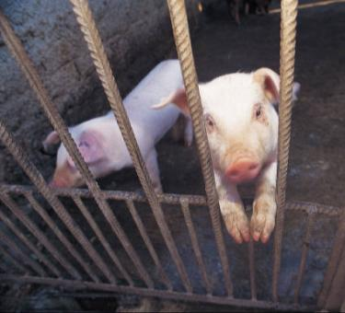
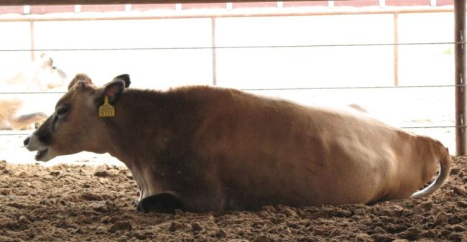
Foot and Mouth Disease
Last reported cases in North America
  U.S., 1929
  Canada, 1952
  Mexico, 1954
Must maintain vigilance to prevent reintroduction
ARS, 1969
USDA-APHIS, 2007
Notes:
Foot and Mouth Disease was last reported in the United States in 1929, Canada in 1952 and Mexico in 1954. It is still found in South America and parts of Asia, Europe, and Africa.
Everyone in agriculture as well as our border security must work together to prevent the reintroduction of Foot and Mouth Disease.

Slide 24

Foot and Mouth Disease
2001 Major Outbreak in United Kingdom
  6 million animals slaughtered
  Estimated cost of 17 billion dollars
ARS, 1969
USDA-APHIS, 2007
Notes:
Although the United Kingdom had been free of FMD for a number of years, in 2001 a major outbreak occurred there. In all, 6 million animals were slaughtered at an estimated cost of 17 billion dollars before the country was declared FMD free again.

Slide 25
Reasons for Losses
Very contagious, so many animals affected
Eradication programs based on slaughter and destroying carcass
Lose international market – quarantine
Lose market nationally, scares consumer
Notes:
The tremendous losses resulted because the disease is very contagious so many animals were affected. Currently eradication programs are based on slaughter and destroying carcasses. In addition, the United Kingdom lost their markets both nationally, because people reduced meat consumption, and internationally because other countries banned importation of meat or milk from the United Kingdom to protect their livestock.

Slide 26
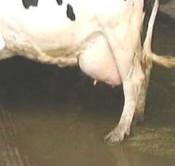
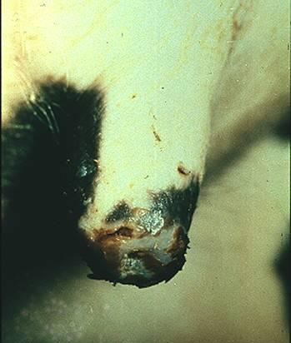
Visual Evaluation of Udder and Teats
Does she have mastitis?
Are there unusual lesions? Report to vet/owner
FMD lesion
Courtesy of Dr. Moeller
Notes:
We must always look for signs of disease in our animals. When you are out in the herd visually evaluating an udder, consider whether the abnormal signs are mastitis, from trauma, or something you don’t recognize. If there are unusual lesions on the teat, is it frost bite or something you don’t recognize? Early identification is the key to preventing the spread of any disease, whether it is an unusual foreign animal disease such as foot and mouth disease or a more common disease like BVD. Whenever there are unusual symptoms report them to the owner, manager, or veterinarian.

Slide 27
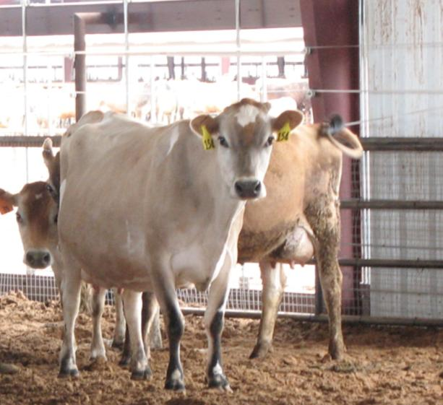
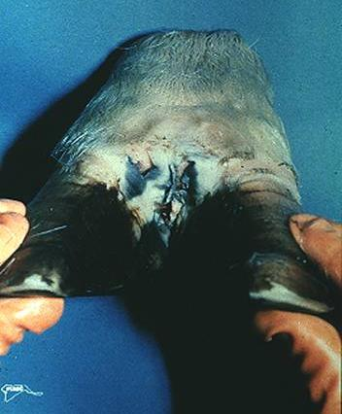
Check the Feet and Legs
Normal Stance
FMD Lesion
Report to Owner/Vet
Courtesy of Dr. Moeller
Notes:
Whether working with the herd in the parlor or in pens, check the feet and legs. Are the cows walking and standing normally or have a number of cows gotten “lame” and you see some lesions between the toes. Whenever you see something you don’t recognize or have a lot of animals come down with something at once, report it at once to the farm manager, owner, or veterinarian.

Slide 28
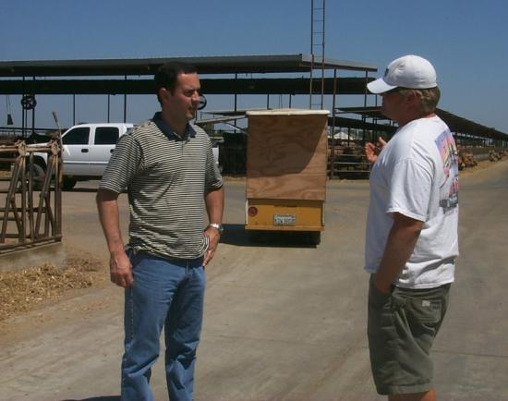
Identify Something Wrong
FMD confused with several other diseases:
  Vesicular stomatitis
  Bluetongue
  Bovine viral diarrhea
  Foot rot
Don’t panic
Tell owner/manager
Let them diagnose WHAT is the problem
Notes:
Foot and Mouth Disease can be confused with other diseases that we do have in this country such as vesicular stomatitis, bovine viral diarrhea, foot rot or blue tongue. Do NOT panic if you don’t recognize something, tell the owner, manager, or veterinarian so they can diagnose the problem. Again, early identification is the key to treating and preventing the spread of any disease.

Slide 29
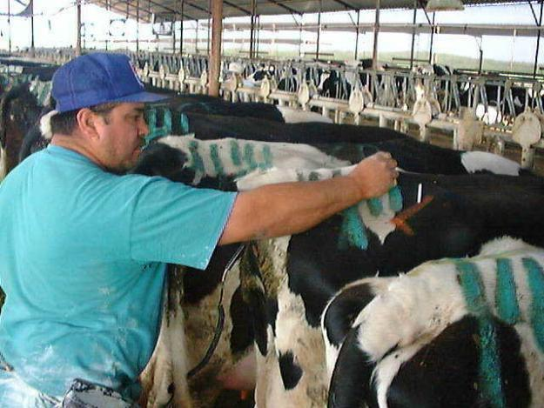
Take the Temperature
Digital thermometers
Record daily results on cow with chalk for “cow side” record
Notes:
Digital thermometers provide rapid readings. Some herds develop a method for recording daily results of temperature readings and treatments directly on the cow between the hooks and pins. There may be different colors for normal and high, as well as a means to indicate treatment. These “cow side” records supplement the written record. Keeping a written record is also important so proper meat and milk withdrawal times can be followed. In addition, written records can be used to identify whether treatments are working.

Slide 30
Interpreting Cow Temperature
Particularly important the first 10 days after calving.
Normal temperature 101.5-102 °F (Normal can range up to 103 ºF if during the heat of the summer)
Elevated temperature > 103 °F = indicates an infection (metritis, mastitis, pneumonia, etc.)
Low temperature < 101 °F = may mean the cow has milk fever, DA, ketosis, or indigestion
Notes:
In most herds, body temperatures between 101.5 and 102 °F are considered normal. Temperatures less than 101 °F are too low and over 103 °F are too high. These values may be adjusted in consultation with the herd owner and veterinarian for particular conditions, such as summer heat stress. The first 10 days after calving is particularly critical. Frequently, temperatures are taken daily for this group of animals.

Slide 31
Can Fever Be the First Sign of Infection?
Number of Cows
Day Postpartum
Overton et al., 2001
Notes:
Temperature increases can be the first sign of illness such as metritis, mastitis, or pneumonia. Cows with milk fever, DA, ketosis, or indigestion may have abnormally low temperatures. It is important to continue monitoring cows for 10 days after calving. Frequently fever is the first sign of an illness. Temperature frequently increases 12-24 hours before other symptoms of a disease such as metritis are observed.

Slide 32
Reasons to Check the Temperature
Identify illness earlier
Minimize antibiotic usage and milk discard by identifying illness earlier
Maintain dry matter intake
Maintain milk production
Minimize involuntary culling
Notes:
There are many reasons to check the temperature of a cow. First we may be able to identify illness 12-24 hours earlier. Early diagnosis and treatment can reduce the amount of treatment required, minimizing antibiotic use and milk discard. Early treatment can help keep the animal eating if it prevents her from getting as sick. By maintaining feed intake, the cow is more likely to continue producing more milk. Early treatment may also result in less involuntary culling by improving treatment success.

Slide 33
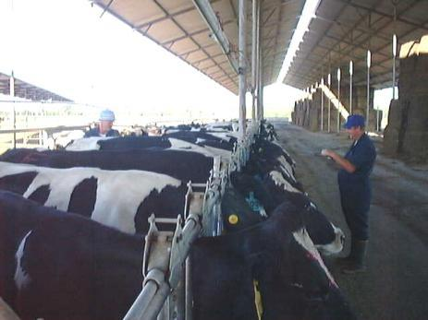
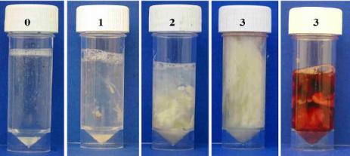
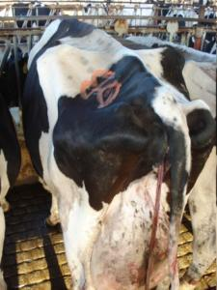
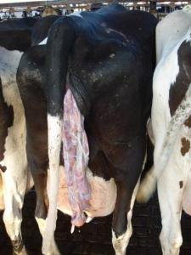
Check the Uterus
Note normal or abnormal discharge
Varies by day after calving
Type of uterine discharges
Palpation of the uterus per rectum is a tool to evaluate uterine discharge and retained placenta
Notes:
Particularly for fresh cows, check to see if there are visible signs of discharge. Some discharge, called lochia, is common immediately after calving. Clear mucus is what is desirable. A cloudy mucus is an abnormal discharge and may require further action. When palpating the uterus through the rectum, observe the discharge color and odor as an aid in determining whether a cow has metritis. Investigate the cause of any foul smelling discharge which may indicate a problem. Follow standard protocols for cows with abnormal discharge.

Slide 34


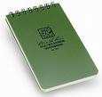

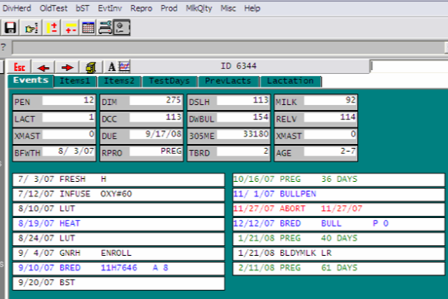
Maintain Records
Date
Cow ID
Symptoms
Diagnosis
Treatment
Withdrawal
Notes:
Record the disease diagnosis and treatment for each cow. At a minimum these records should include the date, cow identification, symptoms, diagnosis, treatment and withdrawal times for meat and milk. Follow set protocols for treatment developed with the herd veterinarian.

Slide 35
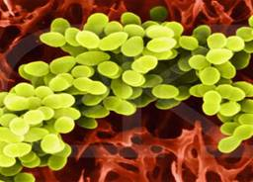
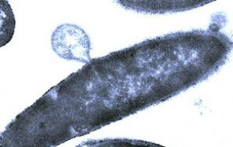
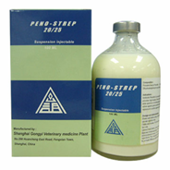
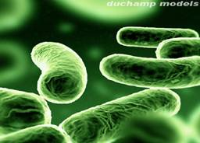

Determine if Antibiotic Treatment Is Necessary
Notes:
If antibiotics are necessary to treat a bacterial infection, follow withdrawal times for both milk and meat.

Slide 36
Before Selecting a Treatment
Do not stop the clinical exam at the first findings – you can miss other signs of disease!!
Try to associate all normal and abnormal signs found during the exam with common diseases
If you don’t recognize something talk to your supervisor and/or herd veterinarian immediately!
Follow the treatment indicated in the dairy’s protocols for each specific illness
In case of no response to treatment – contact your supervisor immediately
Notes:
Before selecting a treatment complete all steps of the exam. Do not stop the clinical exam at the first findings since you can miss other signs of the disease. Consider all of the normal and abnormal signs found during the exam and compare them to what you know about the symptoms of common diseases. IF YOU DON’T RECOGNIZE SOMETHING, TALK TO YOUR SUPERVISOR AND OR HERD VETERINARIAN IMMEDIATELY. Follow the treatment indicated in the dairy’s protocols for each specific illness. If a cow doesn’t respond to the treatment – again contact your supervisor immediately.

Slide 37
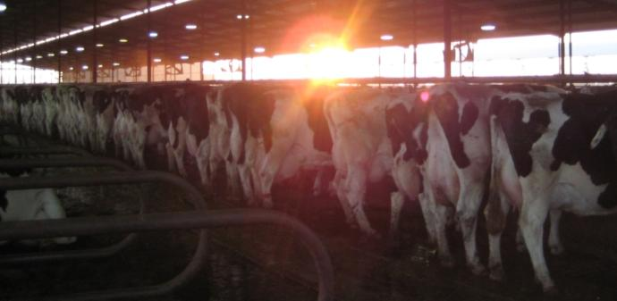
Other Disease Considerations
Nutrition from close-up to freshening
Early assistance in calving if needed
Clean, comfortable bedding
Feed waiting in bunk when cows return from the parlor
Bunk and freestall space for all animals - don’t exceed 80% capacity in transition period
Water
Notes:
Keeping cows healthy goes beyond routine physical exams. Proper nutrition throughout the animal’s life is needed to maintain her immune system. Nutrition from the close-up period immediately before calving through early lactation is particularly important. Providing early assistance in calving, if needed, is critical. Also providing a clean, comfortable environment helps minimize disease. Keeping cows standing for at least 30 minutes after milking by providing fresh feed can reduce mastitis by allowing time for the teat sphincter to close.
Routine evaluation of the cows in a herd with the basic physical exam helps identify sick animals early so that they can be treated. When treatment is needed, follow herd specific protocols and adhere to the label for meat and milk withdrawal periods.
Abnormal symptoms, which could indicate a new disease in the herd, should be reported to the herd owner, veterinarian, or manager immediately. These new diseases could be a foreign or emerging disease. Rapid identification is the key to preventing spread of these diseases.

Slide 38
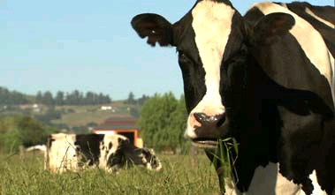
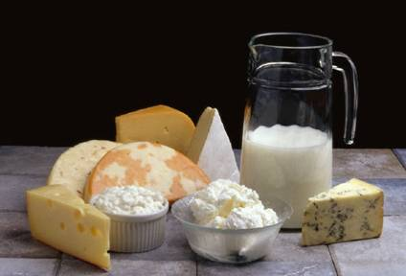
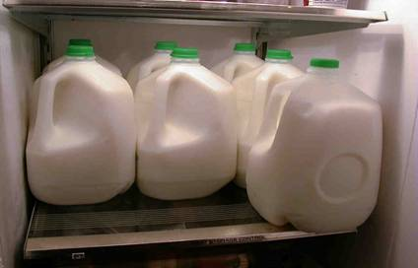
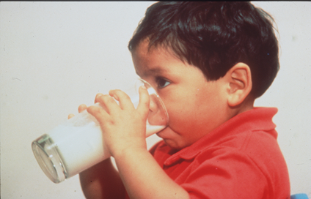
Healthy Cows
Safe Food
Protected Consumers
For more technical articles visit:
texasdairymatters.org
Notes:
Completing the basic physical exam is one step in keeping cows healthy so that they can provide milk that is highly nutritious and safe so the consumer is protected against food borne diseases.

Slide 39
A Collaborative Effort:
Texas AgriLife Extension Service,
New Mexico State University and
University of Idaho
Funding provided by the National Center for Foreign Animal and Zoonotic Disease Defense, a Department of Homeland Security Science and Technology Center of Excellence.
Ellen Jordan, PhD; Ralph Bruno, DVM, MS; Juan A. Hernandez-Rivera, PhD; and Kevin Lager, MS-
Texas AgriLife Extension Service
Mireille Chahine, PhD – University of Idaho
Robert Hagevoort, PhD – New Mexico State University
The entities involved in the development of this material do not support one product over another and any mention herein is meant as an example, not an endorsement.
Notes:
This project was a collaborative effort of Texas AgriLife Extension Service, New Mexico State University and the University of Idaho. Funding was provided by the National Center for Foreign Animal and Zoonotic Disease Defense Center. The entities involved in the development of this material do not support one product over another and any mention herein is meant as an example, not an endorsement.

