Slide 1



Defending the Milk Supply in the Parlor
Ellen Jordan, PhD; Ralph Bruno, DVM, MS; Juan Hernandez-Rivera, PhD; and Kevin Lager, MS
- Texas AgriLife Extension Service
Mireille Chahine, PhD – University of Idaho
Robert Hagevoort, PhD – New Mexico State University
The entities involved in the development of this material do not support one product over another and any mention herein is meant as an example, not an endorsement.
Notes:
Since the terrorist attack of 9-11 the world has changed. Now more than ever, today’s farm workers play a key role in producing, defending, and protecting our food supply. Key steps for employees in the parlor to create a line of defense for the milk supply while performing their regular duties follow.

Slide 2
Parlor Worker Goals
Harvest the highest quality product possible
Take good care of the cows and identify when they are sick
Produce meat and milk that is free of antibiotics
Ensure biosecurity on the farm to protect the herd, yourself, and your family
Notes:
When everyone in the milking parlor works together they can achieve four goals to provide a safe, abundant milk supply for consumers. Those goals include:
Harvest the highest quality product possible.
Take good care of the cows and identify when they are sick.
Produce meat and milk that is free of antibiotics.
Ensure biosecurity on the farm to protect the herd, yourself and your family.
To attain these goals takes pride and attention to detail. The process creates a layer of security for our agriculture products beyond what law enforcement can provide.

Slide 3
Goal 1: Harvest the Highest Quality Product
Notes:
Our first Goal is to: Harvest the Highest Quality Product

Slide 4
Harvest High Quality Products – 5 Steps
Proper milking procedures
Maintain milk equipment
Dip ALL teats after milking
Treat cows
  Mastitis
  Dry off
Cull cows with chronic mastitis
NMC
Notes:
Today we will review five steps to harvesting high quality products as recommended by NMC. These include: 1) using proper, sanitary milking procedures, 2) maintaining the milking equipment, 3) dipping ALL teats after milking, 4) detecting and treating cows with mastitis, as needed, during lactation and at dry off, and 5) culling cows with chronic mastitis.

Slide 5
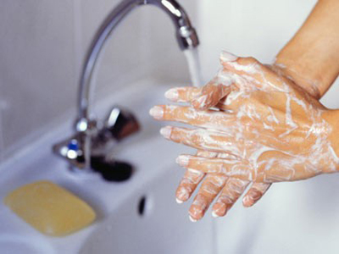
Start with Clean Hands and Wash Your Hands Frequently
Before you start milking
During milking
Before treating or sampling
Before you eat
After done milking
20 seconds
Notes:
Although not always found written in farm protocols, workers must start with clean hands and wash their hands frequently during milking. At a minimum wash hands before milking, during milking when needed, before and after treating a cow for mastitis, before taking a milk sample to culture, prior to eating, and at the end of milking. It takes just 20 seconds to wash your hands correctly. Time well spent to control the spread of germs.

Slide 6
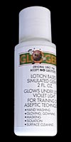
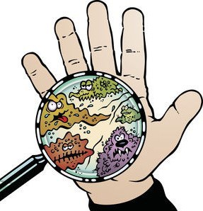
Hand Washing
Six Steps
GloGerm® Simulates
“Germs”
Wet Hands
Soap
Wash for 20 seconds
Rinse
Dry
Turn off water with paper towel
Notes:
There are really six different steps to properly washing your hands. First, you wet your hands. Next you add soap. Then you wash your hands thoroughly making sure you get the palm, heel of the hand, finger tips, nails, and back of the hand. Steps 4 and 5 are rinse and dry. Finally turn off the water with a paper towel, so you don’t contaminate your hands. Today we are going to use a product called “GloGerm®” to simulate how what goes on our hands is not so easy to wash off unless we follow these steps.

Slide 7
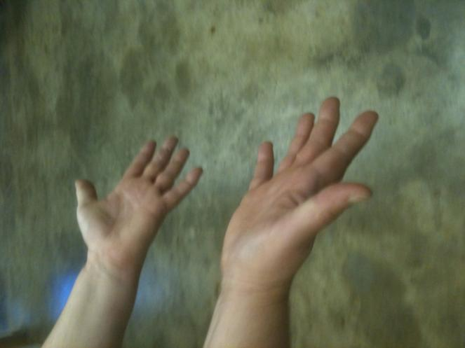
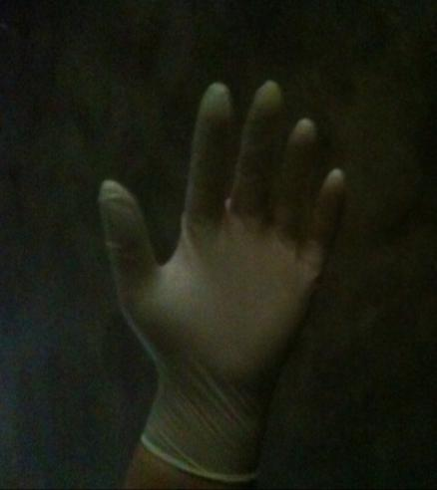
Bare Hands or Gloves
Many cracks and crevices for bacteria to hide
Much smoother surface on gloved hand, easier to clean
Notes:
On many dairies the herd owner wants employees to wear gloves to minimize the spread of germs from one animal to the next. Our hands have many cracks and crevices where the bacteria can hide, particularly when we work hard or during the winter when they become cracked and chaffed. A gloved hand is a much smoother surface, which is much easier to clean.

Slide 8
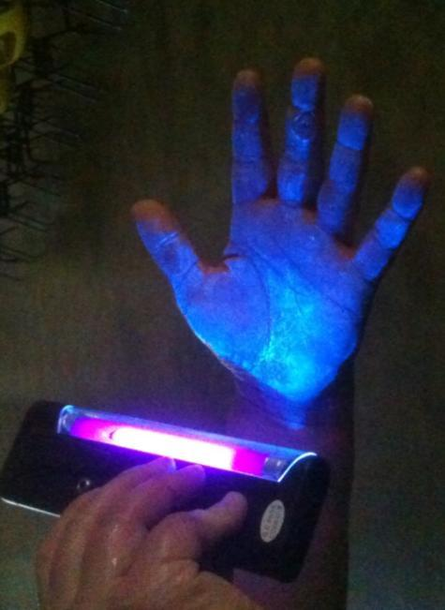
Dirty Hands Spread Bacteria
Cow to Milker to Cow
Equipment to Milker to Cow
Environment to Milker to Cow
Notes:
A dirty hand can spread germs from cow to milker to cow or from equipment or environment to milker to cow. The person whose hand is in this picture had put some “GloGerm®” on their hand and we looked at it under a black light. See how the “GloGerm®” gets in the crevices and in the area around the blister on the middle finger.

Slide 9
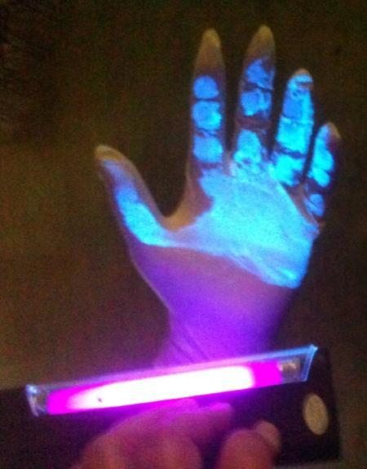
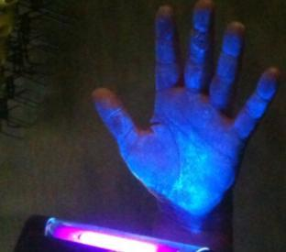
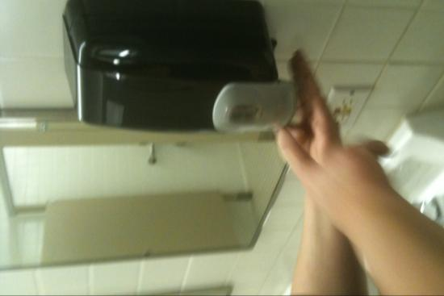
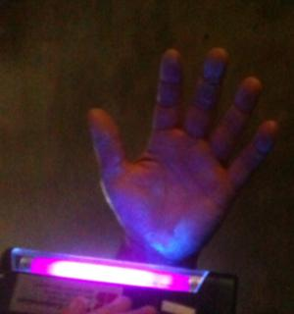
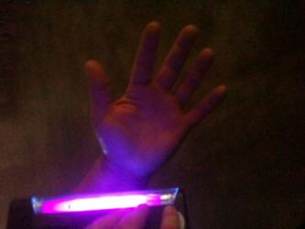
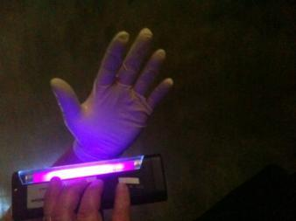
Rinsing Alone Isn’t Enough
Bare Hands
Gloved Hand
Notes:
This slide illustrates the effects of using all six steps to wash either a bare hand or the gloved hand. Note that there is still a “glo” on the heel of the hand and on the tips of the finger on the bare hands after washing the first time. After a second wash almost everything came off, except a spot on the heel of the hand that was “missed”. It was easier to get everything off and have a clean hand when wearing gloves.

Slide 10
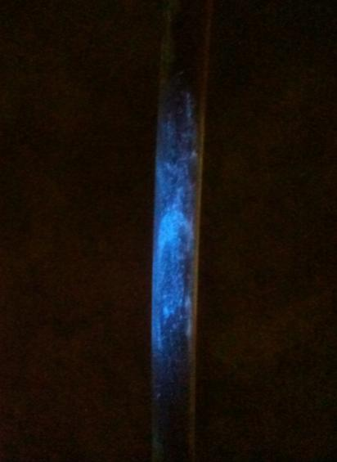
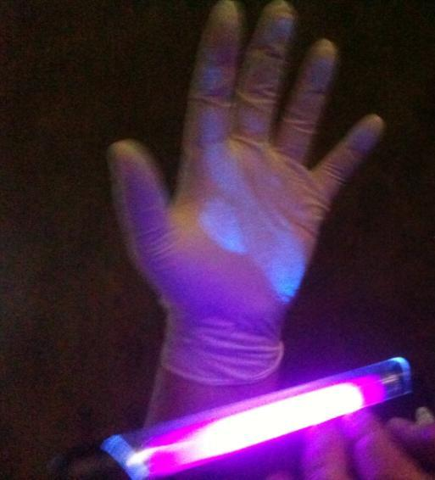
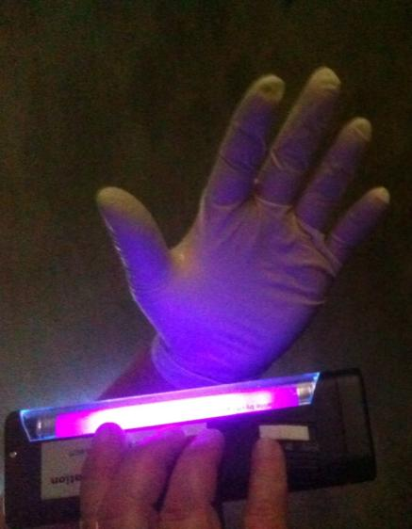
Gloved Hands Can Still Carry Bacteria, but Easier to Clean
The “GloGerm®” transfers
to gloves, too
Touching objects in parlor transfers “GloGerm®”
Notes:
But don’t let gloves give you a false sense of security. When you touch a pipe in the parlor you can still pick up dirt and “germs” on your gloved hand and transfer it to another object, such as a drying cloth, or the next cow you are milking unless you wash your hands thoroughly.

Slide 11
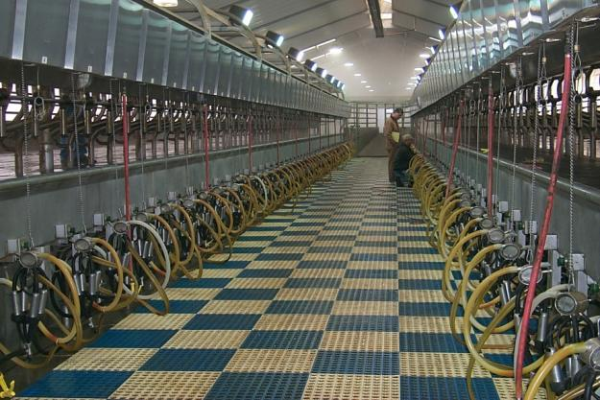
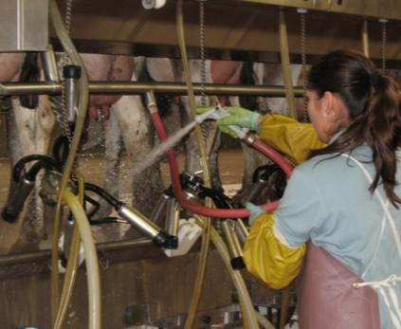
Step 2:
Maintain Milk Equipment
Follow farm procedures for:
  Daily
  Weekly
  Monthly
  Quarterly
  Annual
Equipment maintenance and cleaning
Notes:
Step 2 is to Maintain Milking Equipment
Develop and follow a milking equipment check list. Vary the list depending upon parlor size, type of parlor, equipment installed, and number of cows milked. Some tasks such as sanitizing and washing the equipment will be done daily, while others will be weekly, monthly, quarterly, or annually.
Replace rubber and plastic parts regularly based on manufacturer’s recommendations and specifications, even if they don’t look “worn out”. Notify a supervisor if equipment needs repair.

Slide 12
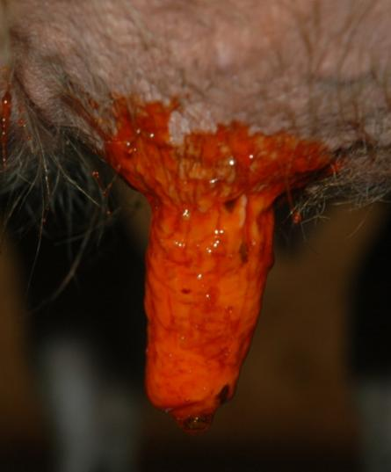
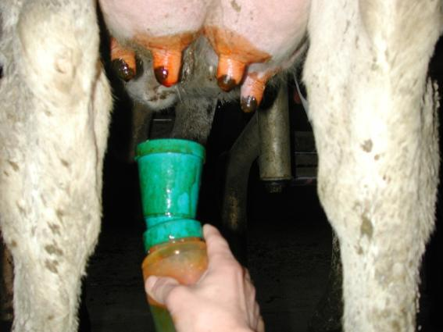
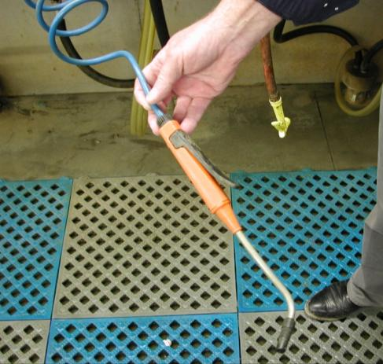
Step 3:
Dip Teats After Milking
Dip ALL teats
Cover entire teat
Notes:
Step 3 is to dip all teats after milking
Apply a teat dip to each and every teat immediately after removing the milking claw. Cover the entire teat. Dipping results in more complete coverage and is preferred to other methods.

Slide 13
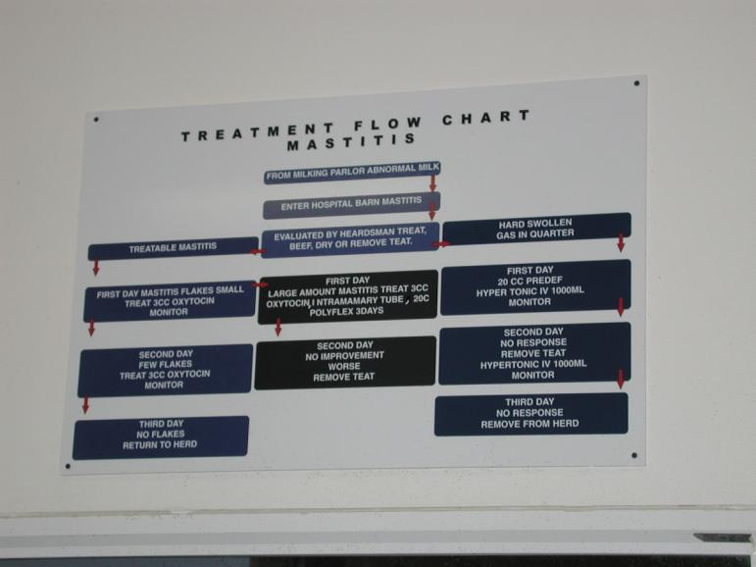
Step 4:
Treat Cows
Follow farm protocols for treating mastitis and for dry cow treatments
Do NOT stop treatments early, give all treatments that were prescribed in farm protocol
Notes:
The 4th step is to treat all cows with mastitis
Identify cows with mastitis. Some signs of mastitis include: painful swelling of one or more quarters; off grade, watery, or bloody milk; and uneven milk out. Do NOT put milk from cows with mastitis into the main tank. When a cow has mastitis, follow farm treatment protocols.
Always mark the cow that has been treated with antibiotics. Treat every quarter of every cow at dry off according to farm protocols. Never stop mastitis therapies before the prescribed treatment period is complete. Record the treatments and the withdrawal times for meat and milk.

Slide 14
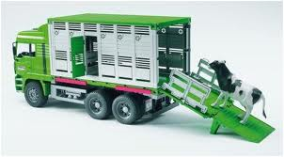
Step 5:
Cull Chronic Mastitis Cows
Farm manager/ owner create standard guidelines
Identify problem cows and tell management
Notes:
Step 5 is to cull chronic mastitis cows.
Each dairy farm manager or owner sets farm specific guidelines for identifying cows that have chronic mastitis. If you see a problem cow in the parlor that hasn’t made the list to cull yet, tell your manager about her and her problem. Review treatment records to insure that meat withdrawal times have been followed prior to sales.

Slide 15
Goal 2: Take Excellent Care of the Cows and Identify when the Cows Are Sick
Notes:
The second overall goal is to take excellent care of the cows and identify when a cow is sick.

Slide 16
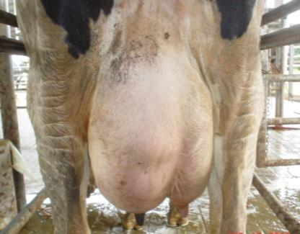
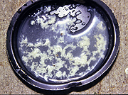
Identifying “Sick” Cows in the Parlor
Traditionally look for mastitis
  Clots
  Hard quarter
  Hot quarter
  Uneven
  Don’t put milk from cows with mastitis into the bulk tank
Notes:
Whenever employees move cattle, slow and easy works best. Take time to look for abnormalities in behavior and appearance when moving the cows to and from the milking parlor. Once in the parlor, identify cows with mastitis, an inflammation of the udder usually caused by a microorganism. When stripping out foremilk, look for clots or any change in milk appearance. Also, when handling the udder feel for hard spots or “hot” spots that may indicate an infection. Check to see if all quarters have milked out evenly. If not, examine the quarter with residual milk for mastitis. Again do NOT put milk from cows with mastitis into the bulk tank.

Slide 17

Look Beyond Typical Symptoms
International travel increases the potential to bring in foreign animal diseases
  Example: Foot and Mouth Disease
Early detection of any disease can prevent its spread and minimizes the impact on the herd
Notes:
When checking a herd, you should always watch for symptoms beyond what you are used to seeing each day. Are there lame cows? Are some cows slow to come to the parlor or leave? Do you see lesions or blisters on the teats, udder, or mouth? Are the cows more restless in the milking parlor? Tell the manager when something is wrong as all of these signs may indicate a herd health problem. Vaccinations protect cows against many common diseases. Early detection of any disease can prevent its spread and minimize the impact on the herd. Many dairy employees are immigrants and may travel out of the U.S. In addition there is more and more international travel by citizens from around the globe. This increases the potential to bring in foreign animal diseases. One example of a foreign animal disease we don’t find in the U.S. is foot and mouth disease. Early detection of any disease, including foreign animal diseases, can prevent its spread and minimizes the impact on the herd.

Slide 18
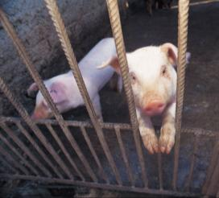
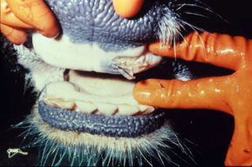
Foot and Mouth Disease (FMD)
Impacts cows, sheep, pigs, deer and other cloven footed animals
Very contagious virus
Fever and blister-like lesions on teats, tongue, lips, and between hooves
Lost milk production
ARS, 1969
USDA-APHIS, 2007
Notes:
Foot and Mouth Disease is caused by a virus. It impacts cows, sheep, pigs, deer, and other cloven hoofed animals. It is a very contagious virus. Animals may have a fever and blister-like lesions on teats, tongue, lips, and between hooves. Milk production decreases dramatically in dairy cows.

Slide 19
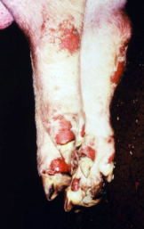
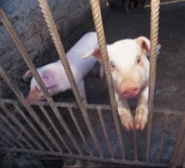
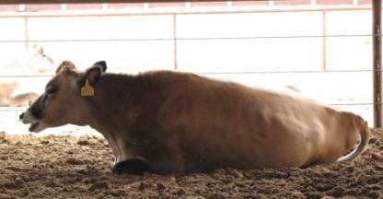
Foot and Mouth Disease
Last reported cases in North America
  U.S., 1929
  Canada, 1952
  Mexico, 1954
Must maintain vigilance to prevent reintroduction
ARS, 1969
USDA-APHIS, 2007
Notes:
Foot and Mouth Disease was last reported in the United States in 1929, Canada in 1952, and Mexico in 1954. It is still found in South America and parts of Asia, Europe, and Africa.
Everyone in agriculture as well as our border security must work together to prevent the reintroduction of Foot and Mouth Disease.

Slide 20
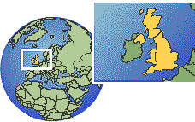
Foot and Mouth Disease
2001 Major Outbreak in United Kingdom
  6 million animals slaughtered
  Estimated cost of 17 billion dollars
ARS, 1969
USDA-APHIS, 2007
Notes:
Although the United Kingdom had been free of FMD for a number of years, in 2001 a major outbreak occurred there. In all, 6 million animals were slaughtered at an estimated cost of 17 billion dollars before the country was declared FMD free again.

Slide 21

Reasons for Losses
Very contagious, so many animals affected
Eradication programs based on slaughter and destroying carcass
Lose international market – quarantine
Lose market nationally, scares consumer
Notes:
The tremendous losses resulted because the disease is very contagious so many animals were affected. Currently eradication programs are based on slaughter and destroying carcasses. In addition, the United Kingdom lost their markets both nationally, because people reduced meat consumption even though FMD doesn’t cause disease in humans, and internationally because other countries banned importation of meat or milk from the United Kingdom to protect their livestock.

Slide 22
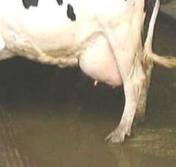
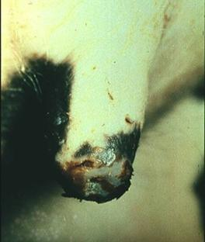
Visual Evaluation of Udder and Teats
Does she have mastitis?
Are there unusual lesions? Report to vet/owner
FMD lesion
Courtesy of Dr. Moeller
Notes:
We must always look for signs of disease in our animals. When you are out in the herd visually evaluating an udder, consider whether the abnormal signs are mastitis, from trauma, or something you don’t recognize. If there are unusual lesions on the teat, is it frost bite or something you don’t recognize? Early identification is the key to preventing the spread of any disease, whether it is an unusual foreign animal disease such as foot and mouth disease or a more common disease like BVD. Whenever there are unusual symptoms report them to the owner, manager, or veterinarian.

Slide 23
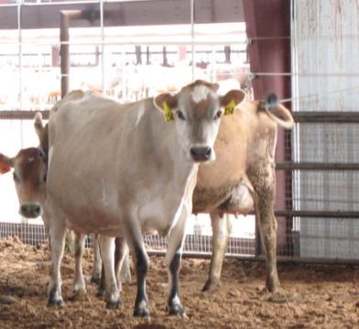
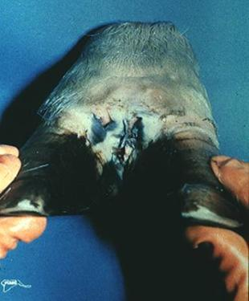
Check the Feet and Legs
Normal Stance
FMD Lesion
Report to Owner/Vet
Courtesy of Dr. Moeller
Notes:
Whether working with the herd in the parlor or in pens, check the feet and legs. Are the cows walking and standing normally or have a number of cows gotten “lame” and you see some lesions between the toes. Whenever you see something you don’t recognize or have a lot of animals come down with something at once, report it immediately to the farm manager, owner, or veterinarian.

Slide 24
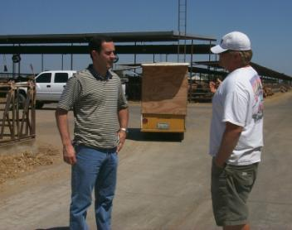
Identify Something Wrong
FMD confused with several other diseases:
  Vesicular stomatitis
  Bluetongue
  Bovine viral diarrhea
  Foot rot
Don’t panic
Tell owner/manager
Let them diagnose WHAT is the problem
Notes:
Foot and Mouth Disease can be confused with other diseases that we do have in this country such as vesicular stomatitis, bovine viral diarrhea, foot rot, or blue tongue. Do NOT panic if you don’t recognize something, tell the owner, manager, or veterinarian so they can diagnose the problem. Again, early identification is the key to treating and preventing the spread of any disease.

Slide 25
Goal 3: Produce Meat and Milk that Is Free of Antibiotics
Notes:
The third goal is to produce both meat and milk that is free of antibiotics.

Slide 26
Antibiotic
Definition:
Antibiotic is a substance or compound that kills bacteria or inhibits their growth (Davey, 2000)
It has been used in food animals since their discovery more than 50 years ago (Penicillin discovered in 1928, therapeutic usage 1940)
Used to treat or prevent diseases
Main issue since discovery Antibiotic Resistance (First report of antibiotic resistance 1946 – indiscriminate usage)
Notes:
An antibiotic is a substance or compound that kills bacteria or inhibits their growth. Penicillin, a common antibiotic, was first discovered in 1928. Other antibiotic discoveries have followed. The therapeutic usage in food animals began shortly after their discovery.

Slide 27
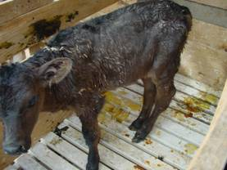
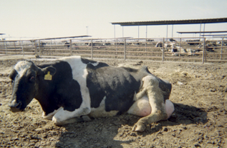
Antibiotic Usage
Necessary to:
  Treat sick animals
  Protect the food supply
MUST be used prudently
Notes:
Antibiotics are used both to treat and prevent diseases in food animals. Approximately 87% of all antibiotics used in animals are for treatment of disease. Antibiotics must be used prudently or their use may be restricted further.

Slide 28
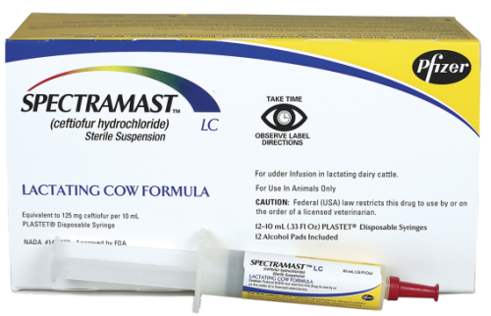
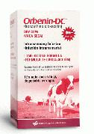
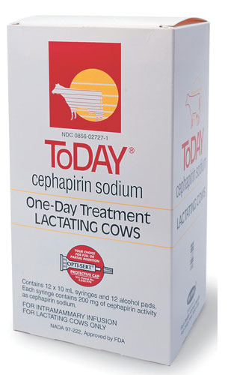
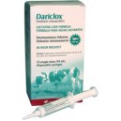
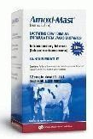
Some Antibiotics Used for Treating Mastitis
Notes:
There are many different kinds of antibiotics or “tubes” used to treat cows. Each has its own withdrawal period and recommended number of treatments. Longer withdrawal periods are typical when the treatment is at the end of a cow’s lactation.

Slide 29
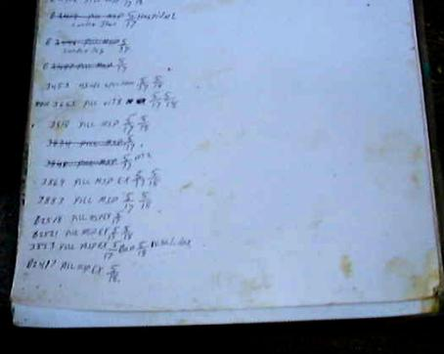

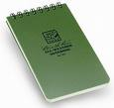
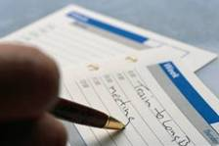
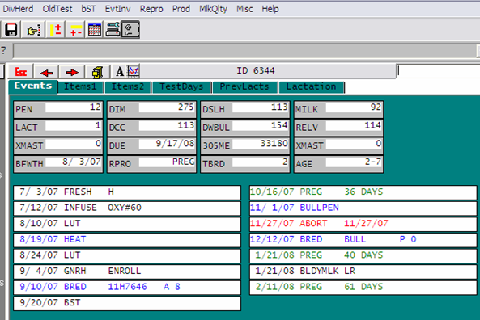
Maintain Treatment Records
Date
Cow ID
Quarter
Diagnosis
Treatment
Withdrawal
Notes:
Whenever using an antibiotic to treat a cow for mastitis, at a minimum record the following information:
Date, Cow ID, Quarter Infected, Diagnosis, Treatment, and Withdrawal time for meat and milk. Move the cow to a separate string or pen if possible to help make sure the milk from that cow is discarded until the withdrawal period is over.

Slide 30
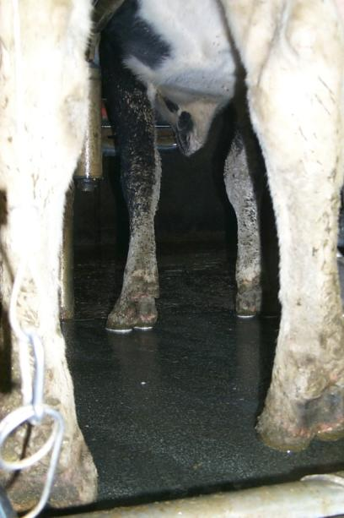
Records help…
Identify new problems
Assist the herd owner determine what may be the cause of illness or disorder
Evaluate whether treatments are working
Track cows to be rechecked or have meat or milk withheld
Notes:
Records help a) identify new problems, b) assist the herd owner determine what may be the cause of an illness or disorder, c) provide information to evaluate whether treatments are working, d) track cows that need to be rechecked or withheld from the meat or milk supply.

Slide 31
What’s the difference between antibiotic residue and antibiotic resistance ?
Notes:
What’s the difference between an antibiotic residue and antibiotic resistance?

Slide 32
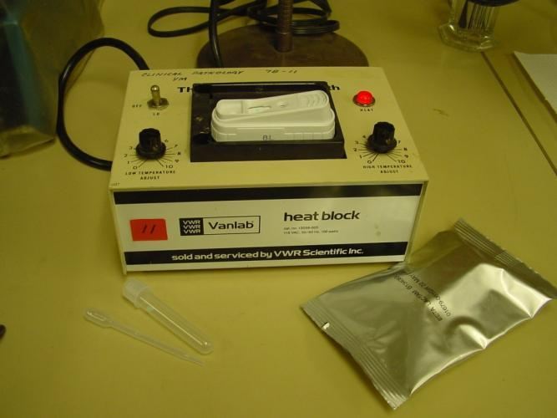
Antibiotic Residue
Detectable amount of antibiotics in meat or milk after using them to treat cows and calves with mastitis, pneumonia, metritis, diarrhea, or other diseases
Notes:
An antibiotic residue is a detectable amount of antibiotics in either the meat, milk or both after using antibiotics to treat cows and calves with mastitis, pneumonia, metritis, diarrhea or other diseases.

Slide 33
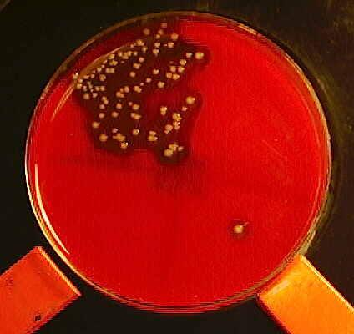
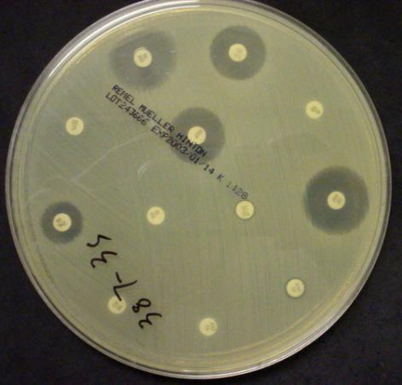
Antibiotic Resistance
Is when an antimicrobial substance, such as an antibiotic, is no longer effective in killing or inhibiting the growth of bacteria
Notes:
Antibiotic resistance is when an antimicrobial substance, like an antibiotic, is no longer effective in killing or inhibiting the growth of bacteria that once was susceptible to it.

Slide 34
Main Concerns with
Antibiotic Use
Food safety – Antibiotic residue in milk, meat, eggs, etc.
Public perception - many bacteria that cause illness are becoming resistant to antibiotics
Concern that antibiotics used on livestock have created part of the resistance problem
Notes:
Antibiotic resistance has been one of the main issues since the discovery of antibiotics. The first report of antibiotic resistance was the result of indiscriminate use reported in 1946.
There are several concerns with antibiotic use.
First, food safety – Is there an antibiotic residue in milk, meat, eggs, etc. Some people have an allergic reaction to antibiotics.
Second, public perception that many bacteria that cause illness in humans are becoming resistant to antibiotics.
Finally there is concern that antibiotics used on livestock have created part of the resistance problem.

Slide 35


Consequences of Residue
Carcass at the slaughter plant or a milk tank positive for antibiotic residue:
  Condemned and discarded
  Producer does not get paid and it is reported to USDA or FDA
http://www.fsis.usda.gov
Notes:
What are the consequences of residues in meat or milk? At the slaughter plant a carcass is condemned and discarded. If a milk tank tests positive for an antibiotic residue the milk is discarded. Either way the producer does not get paid. The violation is reported to USDA or FDA. For meat residues, there is a residue violator list posted on the web. Producers may lose their ability to sell milk or cows for beef depending upon the number of violations and the antibiotics identified.

Slide 36
FSIS Meat Residue Violator List (April 15-22, 2010)
Total Positive Residue Tests: 1,521 (7 days)
Animal Type | Number | %
Cattle | 1,501 | 98.7
Goats | 11 | 0.007
Swine | 5 | 0.003
Horses | 3 | 0.001
Total | 1,521
Cattle | Number | %
Dairy | 837 | 55.8
Beef | 129 | 8.6
Veal | 535 | 35.6
Total | 1,501
Notes:
During 2009, over 99.9% of all milk tanker trucks were negative for antibiotics. On the meat side, the results aren’t acceptable either. The total number of animals slaughtered was not reported by FSIS; however over half of the cattle found in violation during one week in 2010 were from dairy cows. In addition, veal calves had over a third of the animals on the positive residue list that week.

Slide 37

Your Job –
Reduce Risk of Residues
When treating an animal read and follow directions on label or from the farm veterinarian
Record the treatment
Notes:
Your job is to reduce the risk of residues. When treating an animal read and follow directions on the label or from the farm veterinarian. Record the treatment.

Slide 38


If Any Antibiotics Are Used in Treatments…
Mark the cow
Follow discard protocols for milk
Note MEAT withdrawal time
Notes:
If any antibiotics are used in treatments…Mark the cow, follow discard protocols for milk, and
note the MEAT withdrawal time.

Slide 39


Remember -
Two “Withdrawal” Times
Milk
Meat
Notes:
Remember there are two “withdrawal” times - one for milk and one for meat. They may be different lengths.

Slide 40

Communication - Key to Preventing Residues
Communicate to and between employees, owners, and veterinarians
Label all antibiotics
Notes:
Communication is the key to preventing residues. Communicate to and between employees, owners, and veterinarians. Label all antibiotics properly.

Slide 41

Store Drugs Properly
Clean
Temperature controlled
Inventoried
Separate lactating and non-lactating animal medications
Locked
Notes:
Store drugs properly in a clean, temperature controlled, location. Maintain an accurate inventory. Separate lactating and non-lactating animal medications. Keep all drugs locked with only select individuals having the key.

Slide 42
Your Job –
Reducing Potential Resistance
Follow the directions for amount of antibiotic used, the number of times to treat, the route of treatment, and the amount of time between treatments
If a cow doesn’t respond, follow farm policy developed with herd veterinarian for further diagnosis or treatment
Notes:
Your job is to reduce the potential for antibiotic resistance to form in microbes. Follow the directions for the amount of antibiotic to be used, the number of times to treat, the route of treatment, and the amount of time between treatments. If a cow doesn’t respond, follow farm policy developed with the herd veterinarian for further diagnosis or treatment.

Slide 43

Do Resistant Bacteria from Animals Automatically Cause People Harm?
No
A number of events must occur
Notes:
Some people wonder if resistant bacteria from animals automatically cause people harm. A cascade of events must occur for people to be harmed by resistant bacteria.

Slide 44
Cascade of Events That Must Occur for People to Be Harmed
  Must thrive in the animal
  Must leave farm
  Must survive sanitation during harvest of meat or pasteurization of milk
  Must be alive when eaten or contacted by person
  Resistant bacteria must cause illness
  Ill person must go to a doctor
  Doctor must prescribe similar antibiotic
  Patient must get worse or fail to recover
Notes:
There are at least eight different events in the cascade that must occur for a person to be harmed by the resistant microbe. 1) The resistant bacteria must live and multiply in the animal; 2) The resistant bacteria must be taken off the farm; 3) After arriving at the processing plant, the resistant bacteria must survive the sanitation steps during harvesting of the meat or pasteurization of milk; 4) The resistant bacteria must still be alive when eaten or contacted by a person; 5) Once the resistant bacteria is eaten or comes in contact with the person it must be able to multiply and cause some type of an illness; 6) The ill person must be so sick that they go to a doctor; 7) The doctor must then prescribe a similar antibiotic to the patient; and 8) Finally the patient must get worse or fail to recover.

Slide 45
Final Words on Antibiotics
What we all want is:
  production of a healthy, wholesome product
Our goals, when using medications, should include:
  Product, meat or milk, free of residues;
  Prevention of antimicrobial resistance; and
  Meat that is free from injection site lesions that detract from beef quality
Notes:
To conclude goal 3 regarding antibiotics. What we all want is to produce a healthy, wholesome product. Our goals, when using any medication, should include: a product, meat or milk, free of residues; preventing antimicrobial resistance; and meat that is free from injection sites that detracts from beef quality.

Slide 46

Goal 4: Ensure Biosecurity on the Farm and Protect Yourself and Your Family
Notes:
Our fourth goal is to ensure biosecurity on the farm so that you protect not only the farm, but yourself and your family.

Slide 47



What is Biosecurity?
The steps taken to prevent infectious diseases from affecting a herd of animals and the people who care for them.
Notes:
Biosecurity encompasses all the steps taken to prevent infectious diseases from affecting a herd of animals and the people who care for them.

Slide 48



Your Role Is to Help Prevent the Spread of Disease
Clean Equipment
  Parlor
  Farm equipment
  Veterinary supplies
  Clothes
  Boots
Notes:
On a dairy, workers prevent the spread of disease by keeping supplies and equipment clean and well maintained. There are many steps you can take to protect the farm and animals as well as yourself and your family. Always keep equipment clean.
Use separate tractors and loaders for feed and manure. Bacteria live in manure; therefore feed contamination occurs if the same equipment is used for both. If possible, use separate equipment for young stock as well.

Slide 49

Always Wear Clean Clothes
Make sure you have clean clothes for each day
Use the hottest temperature possible
Tumble dry
Laundromat photo
Notes:
Always wear clean clothes. Wear clean clothes to work each day. If you work for multiple employers, change between jobs. Wash clothes in the hottest temperature possible and tumble dry.

Slide 50




Boots
Make sure there is NO dirt on boots
Disinfect between pens (particularly after working in sick pen)
Try to work with youngest animals first
Wash your boots before you leave the farm
Notes:
Check your boots. Make sure there is NO dirt on your boots. Clean and disinfect boots between pens, particularly after working in the “sick” pen. Work with the youngest animals on a farm first and the “sick” pen last. Wash your boots before you leave the farm. Preferably own two pairs of boots, one for work and one for off-farm.

Slide 51

Be Aware of Visitors
Ask visitors to report to the office or to the owner
If you see someone you don’t recognize, TELL the boss
Notes:
Question visitors. Ask visitors to report to the office or to the owner. Don’t assume people wandering around the farm should be there. Know farm protocols that restrict close contact or handling of animals by visitors. Make sure visitors wear clean protective clothing and footwear when they enter the facilities. If you see someone you don’t recognize, TELL the boss.

Slide 52


Lock Gates and Doors as Directed
Drug storage
Bulk tank area
Feed
Water sources
Hazardous chemicals
Notes:
Lock gates and doors as directed. Keep drug storage areas locked to prevent theft and contamination of drugs. Develop a plan to secure bulk tanks that allows haulers to pick up milk, but prevents outsiders from putting anything into the milk supply. Discourage outsiders from accessing feed by using a perimeter fence. Lock well houses to prevent water source contamination. Secure hazardous chemicals to protect workers, children, pets and farm animals.

Slide 53

Report
Sick animals
Suspicious activity or people
Unusual events
Notes:
Report anything out of the ordinary. Follow farm procedures for reporting, treating and recording animals with mastitis, lameness or any other illness. Report suspicious activity of not only visitors, but other employees and service personnel. For example, if a plane flies low over pens, notify your superior. Note whether any spray comes in contact with the cows or feed storage areas.

Slide 54




Follow Set Procedures when Cleaning Parlor, Bulk Tanks, Etc.
Notes:
Clean and sanitize milking equipment. Follow the farm procedures to clean equipment before and after every milking. Sanitize the bulk tank after milk is picked up. Specific procedures vary for each farm and areas within a farm. Follow them. Keep children away from all cleaning compounds.

Slide 55






Specific Procedures Vary for Different Areas
Notes:
Other procedures may be needed for areas away from the parlor, but calves, heifers and cow pens all need to be kept clean following the specific procedures for that area. The same is true for breeding and feeding equipment.

Slide 56



Remember, if You See Something Unusual – REPORT IT!
Lesions
Suspicious activity
Unknown visitors
Abnormal animal behavior
Notes:
Remember, if you see something unusual – REPORT IT! This can be lesions, a high number of animals sick, unknown visitors, or abnormal animal behavior.

Slide 57
Protect Yourself and
Your Family
Remember to wash your hands frequently
  Before you go to the farm
  Before you eat
  After you finish at a farm
20 seconds
Notes:
Protect yourself and your family. Wash your hands and boots before leaving the farm at the end of the day. Protect yourself, your family and your animals by washing your hands frequently - before you go to the farm, before you eat, and after you finish work. Take at least 20 seconds and properly wash your hands.

Slide 58

Protect Your Animals at Home
Change your clothes before working with your animals
Keep a separate pair of boots for when you work at home
Notes:
Protect your animals at home. Change your clothes before working with your animals. Keep a separate pair of boots for when you work at home.

Slide 59
If You Travel Out of the U.S., Realize You May Need to Stay Off Farms When You Return for a Period of Time
For current animal disease concerns when traveling call:
1-866-SAFGUARD
Notes:
If you travel out of the U.S., realize you may need to stay off farms when you return for a period of time. How long will depend upon what country you go to, what diseases are currently active in that country, and whether you visit farms while travelling abroad. Currently the time is 5 days for travelers from countries with Foot and Mouth Disease. Other diseases may differ.

Slide 60
Together We Can Meet the “Parlor Worker Goals”
Harvest the highest quality product possible
Take good care of the cows and identify when they are sick
Produce meat and milk that is free of antibiotics
Ensure biosecurity on the farm to protect the herd, yourself, and your family
Notes:
Together We Can Meet the “Parlor Worker Goals”
Harvest the highest quality product possible.
Take good care of the cows and identify when they are sick.
Produce meat and milk that is free of antibiotics.
Ensure biosecurity on the farm to protect the herd, yourself, and your family.

Slide 61




Healthy Cows
Safe Food
For more technical articles visit:
http://texasdairymatters.org
Protected Consumers
Notes:
As a side benefit workers are part of the first responder defense system for our milk supply. You help make sure we have healthy cows that produce an abundant safe supply of milk and other dairy products to protect the people who eat our products.

Slide 62
This project was a collaborative effort between:
Texas AgriLife Extension Service
New Mexico State University
University of Idaho
Funding provided by the National Center for Foreign Animal and Zoonotic Disease Defense, a Department of Homeland Security Science and Technology Center of Excellence
Ellen Jordan, PhD; Ralph Bruno, DVM, MS; Juan Hernandez-Rivera, PhD; and Kevin Lager, MS -
Texas AgriLife Extension Service
Mireille Chahine, PhD – University of Idaho
Robert Hagevoort, PhD – New Mexico State University
The entities involved in the development of this material do not support one product over another and any mention herein is meant as an example, not an endorsement.
Notes:
This project was a collaborative effort between:
Texas AgriLife Extension Service
New Mexico State University
University of Idaho
Funding was provided by the National Center for Foreign Animal and Zoonotic Disease Defense.
The entities involved in the development of this material do not support one product over another and any mention herein was meant as an example, not an endorsement.

